Slide 1
Classification: Alternative Techniques
Tom Heskes

Slide 2
Rule-based Classifier
Classify records by using a collection of “if…then…” rules
Rule: (Condition) → y
where
Condition is a conjunctions of attributes
y is the class label
LHS: rule antecedent or condition
RHS: rule consequent
Examples of classification rules:
(Blood Type=Warm) ∧ (Lay Eggs=Yes) → Birds
(Taxable Income < 50K) ∧ (Refund=Yes) → Evade=No

Slide 3
Rule-based Classifier (Example)
R1: (Give Birth = no) ∧ (Can Fly = yes) → Birds
R2: (Give Birth = no) ∧ (Live in Water = yes) → Fishes
R3: (Give Birth = yes) ∧ (Blood Type = warm) → Mammals
R4: (Give Birth = no) ∧ (Can Fly = no) → Reptiles
R5: (Live in Water = sometimes) → Amphibians

Slide 4
Application of a Rule-based Classifier
A rule r covers an instance x if the attributes of the instance satisfy the condition of the rule
R1: (Give Birth = no) ∧ (Can Fly = yes) → Birds
R2: (Give Birth = no) ∧ (Live in Water = yes) → Fishes
R3: (Give Birth = yes) ∧ (Blood Type = warm) → Mammals
R4: (Give Birth = no) ∧ (Can Fly = no) → Reptiles
R5: (Live in Water = sometimes) → Amphibians
The rule R1 covers a hawk => Bird
The rule R3 covers the grizzly bear => Mammal

Slide 5
Rule Coverage and Accuracy
Coverage of a rule:
Fraction (relative to the total number) of records that satisfy the antecedent of a rule
Accuracy of a rule:
Fraction (relative to those satisfying the consequent) of records that satisfy both the antecedent and consequent of a rule
(Status=Single) → No
Coverage = 40%, Accuracy = 50%

Slide 6
How Does a Rule-based Classifier Work?
R1: (Give Birth = no) ∧ (Can Fly = yes) → Birds
R2: (Give Birth = no) ∧ (Live in Water = yes) → Fishes
R3: (Give Birth = yes) ∧ (Blood Type = warm) → Mammals
R4: (Give Birth = no) ∧ (Can Fly = no) → Reptiles
R5: (Live in Water = sometimes) → Amphibians
A lemur triggers rule R3, so it is classified as a mammal
A turtle triggers both R4 and R5
A dogfish shark triggers none of the rules

Slide 7
Characteristics of Rule-based Classifiers
Mutually exclusive rules
Classifier contains mutually exclusive rules if the rules are independent of each other
Every record is covered by at most one rule
Exhaustive rules
Classifier has exhaustive coverage if it accounts for every possible combination of attribute values
Each record is covered by at least one rule

Slide 8
From Decision Trees To Rules
Rules are mutually exclusive and exhaustive
Rule set contains as much information as the tree

Slide 9
From Decision Trees To Rules
Initial Rule: (Refund=No) ∧ (Status=Married) → No
Simplified Rule: (Status=Married) → No

Slide 10
Effect of Rule Simplification
Rules are no longer mutually exclusive
A record may trigger more than one rule
Solution?
Ordered rule set
Unordered rule set – use voting schemes
Rules are no longer exhaustive
A record may not trigger any rules
Solution?
Use a default class

Slide 11
Ordered Rule Set
Rules are rank ordered according to their priority
An ordered rule set is known as a decision list
When a test record is presented to the classifier
It is assigned to the class label of the highest ranked rule it has triggered
If none of the rules fired, it is assigned to the default class
R1: (Give Birth = no) ∧ (Can Fly = yes) → Birds
R2: (Give Birth = no) ∧ (Live in Water = yes) → Fishes
R3: (Give Birth = yes) ∧ (Blood Type = warm) → Mammals
R4: (Give Birth = no) ∧ (Can Fly = no) → Reptiles
R5: (Live in Water = sometimes) → Amphibians

Slide 12
Rule Ordering Schemes
Rule-based ordering
Individual rules are ranked based on their quality
Class-based ordering
Rules that belong to the same class appear together

Slide 13
Building Classification Rules
Direct method:
Extract rules directly from data
e.g.: RIPPER, CN2, Holte’s 1R
Indirect method:
Extract rules from other classification models (e.g. decision trees, neural networks,).
e.g: C4.5rules

Slide 14
Direct Method: Sequential Covering
Start from an empty rule
Grow a rule using the Learn-One-Rule function
Remove training records covered by the rule
Repeat Step (2) and (3) until stopping criterion is met

Slide 15
Example of Sequential Covering

Slide 16
Example of Sequential Covering…

Slide 17
Aspects of Sequential Covering
Rule Growing
Instance Elimination
Rule Evaluation
Stopping Criterion
Rule Pruning

Slide 18
Rule Growing
Two common strategies

Slide 19
Rule Growing: CN2
Start from an empty conjunct: {}
Greedily add conjuncts that minimize some entropy measure: {A}, {A,B}, …
Determine the rule consequent by taking majority class of instances covered by the rule

Slide 20
Rule Growing: RIPPER
Start from an empty rule: {} => class
Add conjuncts that maximizes FOIL’s information gain measure:
R0: {A} => class (initial rule)
R1: {A Λ B} => class (rule after adding conjunct: more specific)
Gain(R0, R1) = t [ log (p1/(p1+n1)) – log (p0/(p0 + n0)) ]
where t: number of positive instances covered by both R0 and R1
p0: number of positive instances covered by R0
n0: number of negative instances covered by R0
p1: number of positive instances covered by R1
n1: number of negative instances covered by R1 (note: p1 ≤ p0 and n1 ≤ n0)

Slide 21
Rule Evaluation Metrics
Accuracy
Laplace
M-estimate
n : Number of instances covered by rule
n_{c} : Number of positive instances covered by rule
k : Number of classes
p : Prior probability for positive class

Slide 22
Stopping Criterion and Rule Pruning
Stopping criterion
Compute the gain
If gain is not significant, discard the new rule
Rule Pruning
Similar to post-pruning of decision trees
Reduced Error Pruning:
Remove one of the conjuncts in the rule
Compare error rate on validation set before and after pruning
If error improves, prune the conjunct

Slide 23
Summary of Direct Method
Grow a single rule
Prune the rule (if necessary)
Add rule to Current Rule Set
Remove Instances from rule
Repeat

Slide 24
Direct Method: RIPPER
For 2-class problem, choose one of the classes as positive class, and the other as negative class
Learn rules for positive class
Negative class will be default class
For multi-class problem
Order the classes according to increasing class prevalence (fraction of instances that belong to a particular class)
Learn the rule set for smallest class first, treat the rest as negative class
Repeat with next smallest class as positive class

Slide 25
RIPPER: Growing a Rule
Start from empty rule
Add conjuncts as long as they improve FOIL’s information gain
Stop when rule no longer covers negative examples
Prune the rule immediately using incremental reduced error pruning
Measure for pruning: v = (p-n)/(p+n)
p: number of positive examples covered by the rule in the validation set
n: number of negative examples covered by the rule in the validation set
Pruning method: delete conjunct if without it v is higher on a validation set

Slide 26
RIPPER: Building a Rule Set
Use sequential covering algorithm
Finds the best rule that covers the current set of positive examples
Eliminate both positive and negative examples covered by the rule
Each time a rule is added to the rule set, compute the new description length
stop adding new rules when the new description length is d bits (default: 64) longer than the smallest description length obtained so far

Slide 27
RIPPER: Optimize the Rule Set
For each rule r in the rule set R
Consider 2 alternative rules:
Replacement rule (r*): grow new rule from scratch
Revised rule (r’): add conjuncts to extend the rule r
Compare the rule set for r against the rule set for r* and r’
Choose rule set that minimizes the description length
Repeat rule generation and rule optimization for the remaining positive examples

Slide 28
Indirect Methods

Slide 29
Indirect Method: C4.5rules
Extract rules from an unpruned decision tree
For each rule, r: A → y,
consider an alternative rule r’: A’ → y where A’ is obtained by removing one of the conjuncts in A
Compare the pessimistic error rate for r against all r’-s
Prune if one of the r’-s has lower pessimistic error rate
Repeat until we can no longer improve generalization error
Use class-based ordering: order subsets of rules that correspond to the same class

Slide 30
Example

Slide 31
C4.5 versus C4.5rules versus RIPPER
C4.5rules:
(Give Birth=No, Can Fly=Yes) → Birds
(Give Birth=No, Live in Water=Yes) → Fishes
(Give Birth=Yes) → Mammals
(Give Birth=No, Can Fly=No, Live in Water=No) → Reptiles
( ) → Amphibians
RIPPER:
(Live in Water=Yes) → Fishes
(Have Legs=No) → Reptiles
(Give Birth=No, Can Fly=No, Live In Water=No) → Reptiles
(Can Fly=Yes,Give Birth=No) → Birds
() → Mammals

Slide 32
C4.5 versus C4.5rules versus RIPPER
C4.5 and C4.5rules:
RIPPER:

Slide 33
Advantages of Rule-Based Classifiers
As highly expressive as decision trees
Easy to interpret
Easy to generate
Can classify new instances rapidly
Performance comparable to decision trees

Slide 34
Instance-Based Classifiers
Store the training records
Use training records to predict the class label of unseen cases

Slide 35
Examples of Instance Based Classifiers
Rote-learner
Memorizes entire training data and performs classification only if attributes of record match one of the training examples exactly
Nearest neighbor
Uses k “closest” points (nearest neighbors) for performing classification

Slide 36
Nearest Neighbor Classifiers
If it walks like a duck, quacks like a duck, then it’s probably a duck
Compute Distance
Test Record
Training Records
Choose k of the “nearest” records

Slide 37
Nearest-Neighbor Classifiers
Requires:
The set of stored records
A distance metric to compute distance between records
The value of k, the number of nearest neighbors to retrieve
To classify an unknown record:
Compute distance to other training records
Identify k nearest neighbors
Use class labels of nearest neighbors to determine the class label of unknown record (e.g., by taking majority vote)

Slide 38
Definition of Nearest Neighbor
k-nearest neighbors of a record x are those data points that have the k smallest distance to x

Slide 39
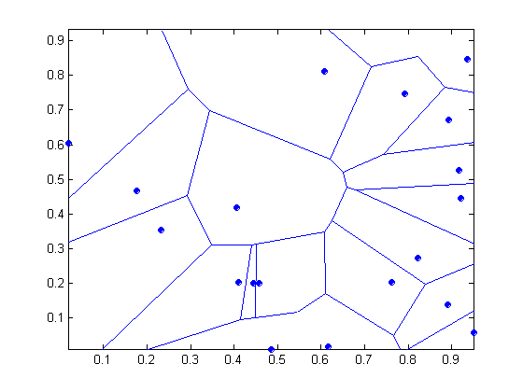
1 nearest-neighbor
Voronoi Diagram

Slide 40
Nearest Neighbor Classification
Compute distance between two points, e.g., using Euclidean distance:
Determine the class from nearest neighbor list
Take the majority vote of class labels among the k-nearest neighbors
Weigh the vote according to distance, e.g., with weight factor, w = 1/d²

Slide 41
Nearest Neighbor Classification: Choice of k
If k is too small, sensitive to noise points
If k is too large, neighborhood may include points from other classes

Slide 42
Nearest Neighbor Classification: Scaling Issues
Attributes may have to be scaled to prevent distance measures from being dominated by one of the attributes
Example:
height of a person may vary from 1.5m to 1.8m
weight of a person may vary from 90lb to 300lb
income of a person may vary from $10K to $1M
Can also work with other distance measures

Slide 43
Nearest neighbor Classification: Lazy Learning
“Lazy learners” do not build models explicitly
To be contrasted with “eager learners” such as decision tree induction, rule-based systems, neural networks, …
Classifying unknown records is relatively expensive

Slide 44
Bayes Classifier
A probabilistic framework for solving classification problems
Conditional probability:
Bayes theorem:

Slide 45
Example of Bayes Theorem
Given:
A doctor knows that meningitis causes stiff neck 50% of the time
People without meningitis have a stiff neck with probability 1/20
Prior probability of any patient having meningitis is 1/50,000
If a patient has stiff neck, what’s the probability he/she has meningitis?

Slide 46
Bayesian Classifiers
Consider each attribute and class label as random variables
Given a record with attributes (A₁, A₂,…,A_{n})
Goal is to predict class C
Specifically, we want to find the value of C that maximizes P(C| A₁, A₂,…,A_{n} )
Can we estimate P(C| A₁, A₂,…,A_{n} ) directly from data?

Slide 47
Bayesian Classifiers
Approach:
compute the posterior probability P(C | A₁, A₂, …, A_{n}) for all values of C using Bayes theorem
Choose the value of C that maximizes P(C | A₁, A₂, …, A_{n})
Equivalent to choosing value of C that maximizes P(A₁, A₂, …, A_{n}|C) P(C)
How to estimate P(A₁, A₂, …, A_{n} | C )?

Slide 48
Naïve Bayes Classifier
Assume independence among attributes A_{i} when class is given:
P(A₁, A₂, …, A_{n} |C) = P(A₁| C) P(A₂| C)… P(A_{n}| C)
Can estimate P(A_{i}| C) for all A_{i} and C from training data.
New point is classified to C=j if P(A₁, A₂, …, A_{n}|C=j) P(C=j) is maximal.

Slide 49
How to Estimate Probabilities from Data: Discrete Data
Class: P(C=k) = N_{k} / N
e.g., P(No) = 7/10, P(Yes) = 3/10
For discrete attributes: P(A_{i}=a| C=k) = |A_{i}=a; C=k| / N_{k}
where |A_{i}=a; C=k| is the number of instances having attribute A_{i}=a and belonging to class k
Examples:
P(Status=Married|No) = 4/7 P(Refund=Yes|Yes) = 0

Slide 50
How to Estimate Probabilities from Data: Continuous Data
Discretize the range into bins
One ordinal attribute per bin
Clearly violates independence assumption...
Two-way split: (A < v) or (A > v)
Choose one of the two splits as new attribute
Probability density estimation:
Assume attribute follows , for example, a normal distribution
Use data to estimate parameters of distribution (e.g., mean and standard deviation)
Once probability distribution is known, use it to estimate the conditional probability P(A_{i}|C)

Slide 51
How to Estimate Probabilities from Data?
Normal distribution:
One for each (A_{i},C=j) pair
For (Income, Class=No):
If Class=No:
sample mean = 82
sample variance = 207

Slide 52
Example of Naïve Bayes Classifier
Given a Test Record: X = (Refund = No, Married, Income = 120K)
P(X | Class=No) = P(Refund=No | Class=No) × P(Married | Class=No) × P(Income=120K | Class=No) = 4/7 × 4/7 × 0.88 = 0.29
P(X|Class=Yes) = P(Refund=No | Class=Yes) × P(Married | Class=Yes) × P(Income=120K | Class=Yes) = 1 × 0 × 0.0086 = 0
Since P(X | No)P(No) > P(X | Yes)P(Yes)
Therefore P(No | X) > P(Yes | X) => Class = No
3
3
82
207
155
3175

Slide 53
Naïve Bayes Classifier: Handling Zeroes
If one of the conditional probabilities is zero, then the entire expression becomes zero...
Probability estimation:
c: number of options a
p_{a}: prior probability of a
m: parameter

Slide 54
Example of Naïve Bayes Classifier
A: all attributes together
M: mammals
N: non-mammals
P(A | M)P(M) > P(A | N)P(N)
=> Mammals

Slide 55
Naïve Bayes Summary
Robust to isolated noise points
Handle missing values by ignoring the instance during probability estimate calculations
Robust to irrelevant attributes
Conditional independence assumption may not hold for some attributes
Use other techniques such as Bayesian networks to model the probability distribution of the attributes given the class

Slide 56
Artificial Neural Networks (ANN)
Output Y is 1 iff at least two of the three inputs are equal to 1

Slide 57
Artificial Neural Networks (ANN)

Slide 58
Artificial Neural Networks (ANN)
Model is an assembly of inter-connected nodes and weighted links
Output node sums up each of its input value according to the weights of its links
Compare output node against some threshold t
Perceptron Model
or

Slide 59
General Structure of ANN
Training ANN means changing the weights

Slide 60
Algorithm for learning ANN
Initialize the weights (w₀, w₁, …, w_{k})
Adjust the weights in such a way that the output of ANN is consistent with the class labels of the training examples
Objective function:
Find the weights that minimize the above objective function e.g., using the so-called backpropagation algorithm
Revival of “deep learning”: clever ways to initialize the weights in combination with lots of data to learn huge neural networks

Slide 61
Support Vector Machines
Find a linear hyperplane (decision boundary) that will separate the data

Slide 62
Support Vector Machines
One possible solution

Slide 63
Support Vector Machines
Another possible solution

Slide 64
Support Vector Machines
Other possible solutions

Slide 65
Support Vector Machines
Which one is better? B1 or B2?
How do you define better?

Slide 66
Support Vector Machines
Find the hyperplane that maximizes the margin => B1 is better than B2

Slide 67
Support Vector Machines

Slide 68
Support Vector Machines: Constrained Optimization
We want to maximize: which is equivalent to minimizing:
But we would like to satisfy the constraint that all data points are correctly classified:
This is a constrained optimization problem, with various numerical approaches for solving it (e.g., quadratic programming)

Slide 69
Support Vector Machines: Nonlinearly Separable Case

Slide 70
Support Vector Machines: Nonlinearly Separable Case
Introduce “slack” variables ξ to allow for errors
Constraints now become
Still want to minimize the norm, but also the amount of errors, so now:

Slide 71
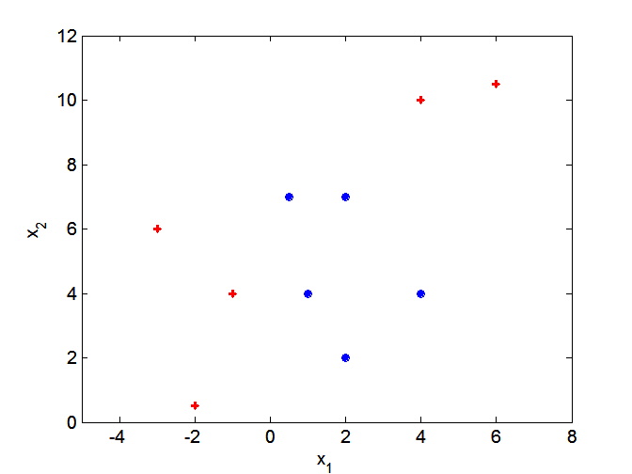
Nonlinear Support Vector Machines

Slide 72
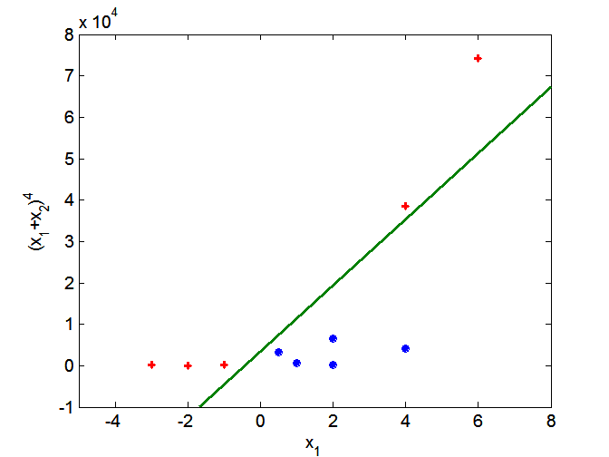
Nonlinear Support Vector Machines
Transform data into higher dimensional space and apply a linear SVM in this space
The so-called “kernel trick” makes the transformation implicit instead of explicit
Transformation back to the original space gives a nonlinear boundary

Slide 73
Ensemble Methods
Construct a set of classifiers from the training data
Predict class label of previously unseen records by aggregating predictions made by multiple classifiers
Examples: bagging and boosting

Slide 74
General Idea

Slide 75
Why does it work?
Suppose there are 25 base classifiers
Each classifier has an error rate, ε = 0.35
Assume classifiers are independent
Probability that the ensemble classifier makes a wrong prediction:
Catch: classifiers are trained on different parts of the data are clearly dependent
Basic argument still applies for instable classifiers such as decision trees and neural networks

Slide 76
Bagging
Sampling with replacement
Build classifier on each bootstrap sample
Each sample has probability (1 – 1/N)^{N} of being selected at least once

Slide 77
Boosting
An iterative procedure to adaptively change distribution of training data by focusing more on previously misclassified records
Initially, all N records are assigned equal weights
Unlike bagging, weights may change at the end of boosting round
Records that are wrongly classified will have their weights increased
Records that are classified correctly will have their weights decreased

Slide 78
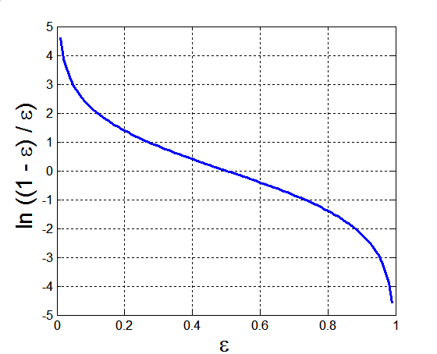
AdaBoost
Base classifiers: C₁, C₂, …, C_{T}
Error rate:
Importance of a classifier:

Slide 79
AdaBoost
Weight update:
Fallback: if any intermediate rounds produce error rate higher than 50%, the weights are reverted back to 1/N and the resampling procedure is repeated
Classification:

Slide 80
Illustrating AdaBoost
Initial weights for each data point
Data points for training

Slide 81
Illustrating AdaBoost

